Slide 1
REACT NATIVE (PART -2)
CROSS PLATFORM MOBILE APP DEVELOPMENT
By , Prabhu V
(FirstQA Systems Private Limited)

Slide 2
RN PART-1 Concepts REFRESH (5 min)

Slide 3
CONTENTS
Different ways for navigating between screens
Images, Animation
Timers
NativeBase or ( React Native Elements )
Debugging
Performance
AsyncStorage
RefreshControl
Generating Signed APK

Slide 4
WAYS OF Navigating between SCREENS
React Navigation
React Native Router

Slide 5
REACT NAVIGATION
Mobile apps are rarely made up of a single screen. Managing the presentation of, and transition between, multiple screens is typically handled by what is known as a navigator.
Stack Navigator
Tab Navigator
Drawer Navigator

Slide 6
1.STACK NAVIGATOR
StackNavigator which simply means adding screens on top of each other like a stack.
App.js // import {createStackNavigator, createAppContainer} from 'react-navigation';
const MainNavigator = createStackNavigator({
Home: {screen: HomeScreen},
Profile: {screen: ProfileScreen},
});
const App = createAppContainer(MainNavigator);
export default App;

Slide 7
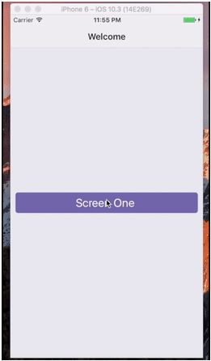
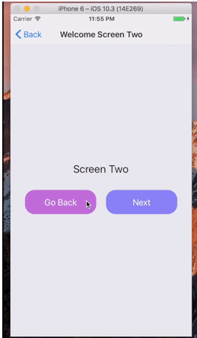
HomeScreen.js //
class HomeScreen extends React.Component {
static navigationOptions = {
title: 'Welcome', // ${navigation.state.params.screen}
};
render() {
const {navigate} = this.props.navigation;
return (
<Button
title=”Screen One"
onPress={() => navigate(’Profile', {screen: ’Screen Two'})}
/>
);
}
}

Slide 8
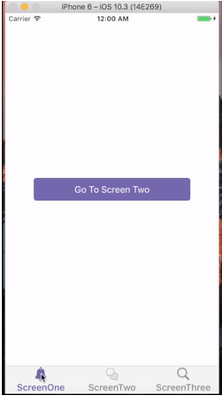
2.TAB NAVIGATOR
App.js // const App = TabNavigator({
ScreenOne: { screen: ScreenOne },
ScreenTwo: { screen: ScreenTwo },
ScreenThree: { screen: ScreenThree }
}, {
tabBarOptions: {
activeTintColor: '#7567B1',
labelStyle: {
fontSize: 16,
fontWeight: '600'
}
}
});

Slide 9
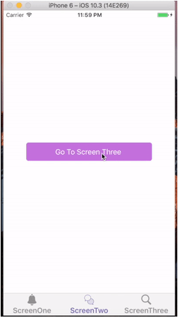
class ScreenOne extends Component {
static navigationOptions = {
title: 'Welcome',
tabBarLabel: 'ScreenOne',
tabBarIcon: ({ tintColor }) => (
<Image
source={require('../images/notification-icon.png')}
style={[styles.icon, { tintColor: tintColor }]}
/>
)
}
render() {
const { navigate } = this.props.navigation;
return (
<View style={styles.container}>
<TouchableHighlight
onPress={() => navigate('ScreenTwo')}
style={[styles.button, {backgroundColor: '#7567B1'}]}>
<Text>Go To Screen Two </Text>
</TouchableHighlight>
</View>
);
}
}

Slide 10
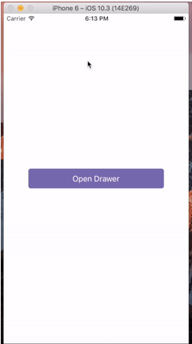
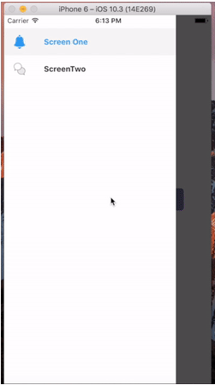
3.DRAWER NAVIGATOR
class ScreenOne extends Component {
static navigationOptions = {
drawerLabel: 'Screen One',
drawerIcon: ({ tintColor }) => (
<Image
source={require('../images/notification-icon.png')}
style={[styles.icon, { tintColor: tintColor }]}
/>
)
}
render() {
const { navigate } = this.props.navigation;
return (
<View style={styles.container}>
<TouchableHighlight
onPress={() => navigate('DrawerOpen')}
style={[styles.button, {backgroundColor: '#7567B1'}]}>
<Text style={styles.buttonText}> Open Drawer </Text>
</TouchableHighlight>
</View>
);}}

Slide 11
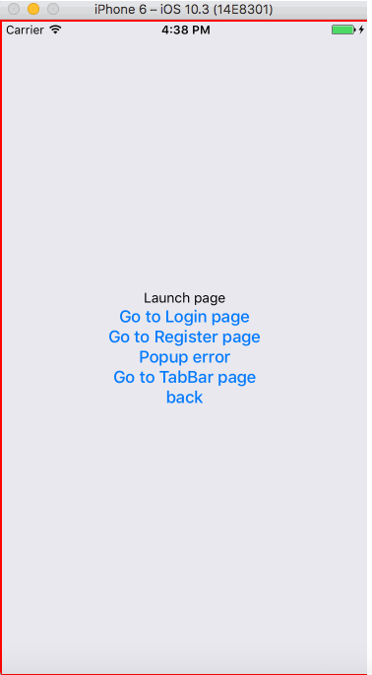
REACT NATIVE ROUTER
App.js // const App = () => (
<Router>
<Stack key="root">
<Scene key="login" component={Login} title="Login"/>
<Scene key="register" component={Register} title="Register”/>
<Scene key="home" component={Home}/>
</Stack>
</Router>
);
// navigate to 'home' as defined in your top-level router
Actions.home(PARAMS)
// go back (i.e. pop the current screen off the nav stack)
Actions.pop()
// refresh the current Scene with the specified props
Actions.refresh({param1: 'hello', param2: 'world'})

Slide 12
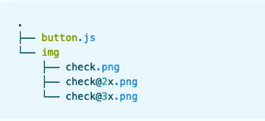
IMAGES
React Native provides a unified way of managing images and other media assets in your iOS and Android apps.
STATIC IMAGE SOURCES
<Image source={require('./my-icon.png')} />
Also, if you have my-icon.ios.png and my-icon.android.png, the packager will pick the correct file for the platform.
<Image source={require('./img/check.png')} />

Slide 13
BACKGROUND IMAGES via NESTING
NETWORK IMAGES
<Image source={{uri: 'https://facebook.github.io/react/logo-og.png'}} style={{width: 400, height: 400}} />
return (
<ImageBackground source={...} style={{width: '100%', height: '100%'}}>
<Text>Inside</Text>
</ImageBackground>
);

Slide 14
ANIMATIONS
Animations are very important to create a great user experience.
1. Slide Animation
2. Parallel Animation - Starts a number of animations at the same time. 3. Sequence Animation - Starts the animations in order, waiting for each to complete before starting the next. 4. Stagger Animation - Starts animations in order and in parallel, but with successive delays.

Slide 15
TIMERS
Timers are an important part of an application which allows us to delay the execution of the instructions.
setTimeout, clearTimeout
setInterval, clearInterval
setImmediate, clearImmediate
requestAnimationFrame, cancelAnimationFrame

Slide 16
REFRESH CONTROL
This component is used inside a ScrollView or ListView to add pull to refresh functionality. When the ScrollView is at scrollY: 0, swiping down triggers an onRefresh event.
import { ScrollView, RefreshControl } from 'react-native';
class RefreshableList extends Component {
constructor(props) {
super(props);
this.state = {
refreshing: false,
};
}

Slide 17
_onRefresh = () => {
this.setState({refreshing: true});
fetchData().then(() => {
this.setState({refreshing: false});
});
}
render() {
return (
<ScrollView
refreshControl={
<RefreshControl
refreshing={this.state.refreshing}
onRefresh={this._onRefresh}
/>
}
.../>); } ...}

Slide 18
ASYNC STORAGE
AsyncStorage is React Native’s API for storing data persistently over the device. It’s a storage system that developers can use and save data in the form of key-value pairs. It is asynchronous, so each of its methods returns a Promise object and in case of error, an Error object. Basic Actions to Perform in AsyncStorage : 1. set an item, along with its value 2. retrieve an item’s value 3. remove an item

Slide 19
1.Save to AsYNC STORAGE
const userId = '8ba790f3-5acd-4a08-bc6a-97a36c124f29';
const saveUserId = async userId => {
try {
await AsyncStorage.setItem('userId', userId);
} catch (error) {
// Error retrieving data
console.log(error.message);
}
};

Slide 20
2.RETRIVE VALUE FROM AsYNC STORAGE
const getUserId = async () => {
let userId = '';
try {
userId = await AsyncStorage.getItem('userId') || 'none';
} catch (error) {
// Error retrieving data
console.log(error.message);
}
return userId;
}

Slide 21
3.DELETE FROM AsYNC STORAGE
const deleteUserId = async () => {
try {
await AsyncStorage.removeItem('userId');
} catch (error) {
// Error retrieving data
console.log(error.message);
}
}

Slide 22

REACT NATIVE ELEMENTS
The aim of React Native Elements is to provide an all-in-one UI kit for creating apps in react native. React Native Elements takes the hassle of assembling these packages together by giving you a ready made kit with consistent api and look and feel.

Slide 23
DEBUGGING
Errors - In-app errors are displayed in a full screen alert with a red background inside your app. This screen is known as a RedBox. You can use console.error() to manually trigger one.
Warnings - As with a RedBox, you can use console.warn() to trigger a YellowBox. YellowBoxes can be disabled during development by using console.disableYellowBox = true;
React Native Inspector – Install react-devtools and you can make use of this inspector for inspecting the elements while the app is running.

Slide 24
GENERATING SIGNED APK
Install Expo CLI
Configure App.json ( package name , buildname )
Start the build using command expo build:android
Wait for it to finish building
Now, The APK is generated and is available on Expo Account.
Download it and Test it on your device.

Slide 25
REFERENCES
React Navigation - https://www.codementor.io/blessingoraz/understanding-navigation-in-react-native-a3wlcxmzu
Generating Build - https://facebook.github.io/react-native/docs/signed-apk-android
AsyncStorage - https://medium.com/building-with-react-native/what-is-asyncstorage-in-react-native-and-how-you-to-use-it-with-app-state-manager-1x09-b8c636ce5f6e
NativeBase - https://docs.nativebase.io/Components.html#Components

Slide 26
NATIVEBASE
NativeBase is made from effective building blocks referred to as components.
The Components are constructed in pure React Native platform along with some JavaScript functionality with rich set of customizable properties.
These components allow you to quickly build the perfect interface.
NativeBase includes components such as layouts, header, footer, textbox, buttons, badge, icons, inputgroup, list etc.

Slide 27
Thank YOU.!

